Slide 1
Aspect-Based Sentiment Analysis Recommender System
Qasim Naveed
Rameez
21L-5231
21L-1775
Afnan Asif
Taha Sheikh
21IL-1864
21L-5175

Slide 2
Agenda
Introduction
1
2
Data Exploration
Preprocessing
3
4
Aspect Classification
Sentiment Analysis
5
6
Recommendation Logic
Deployment
7
8
Conclusion

Slide 3
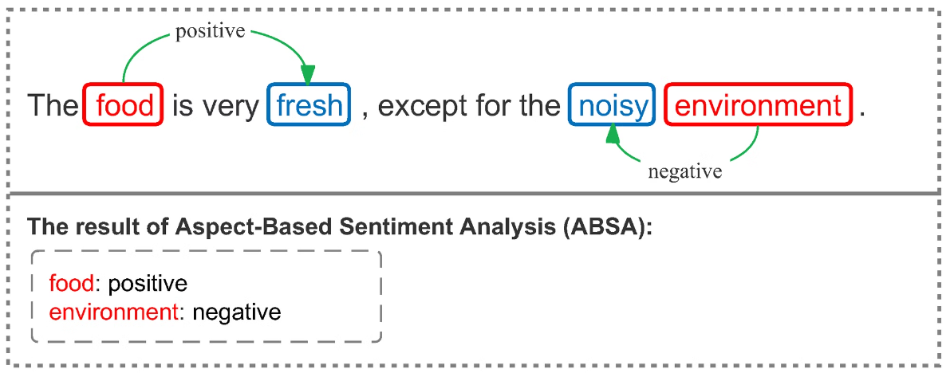
Introduction
What is ABSA?
Aspect-Based Sentiment Analysis breaks reviews into aspects and analyzes sentiments for each.
Why is ABSA important?
Helps businesses understand detailed customer feedback.
Powers personalized product recommendations.

Slide 4
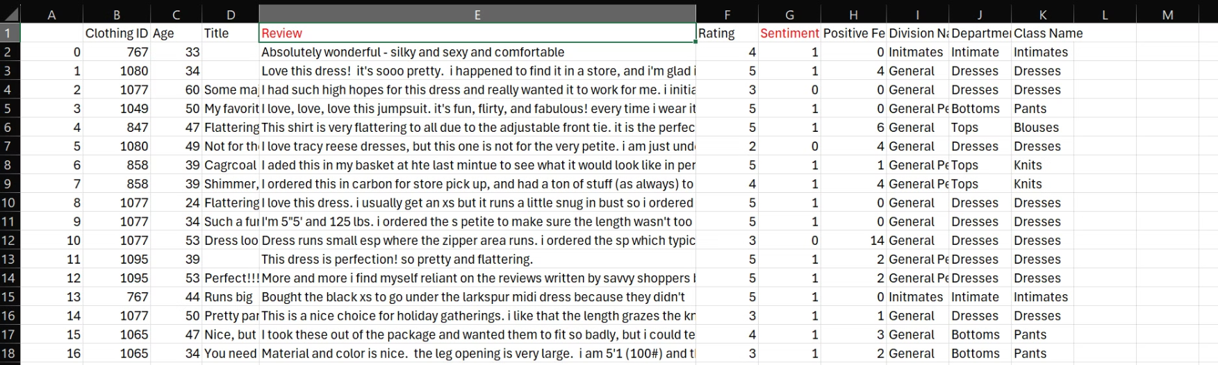
Dataset Overview
Dataset: Women Clothing E-Commerce Reviews (Kaggle).
Key Features:
Review Text: Detailed customer reviews.
Rating: Numerical scores.
Recommended IND: Binary indicator for product recommendation.
Total Records: ~23,000

Slide 5
Data Preprocessing
Why Preprocessing?
Remove noise for better model performance.
Standardize input for consistent analysis.
Steps Taken:
Lowercasing, punctuation removal, stopword removal.
Balancing the positive and negative sentiments.
Lemmatization to normalize words.

Slide 6
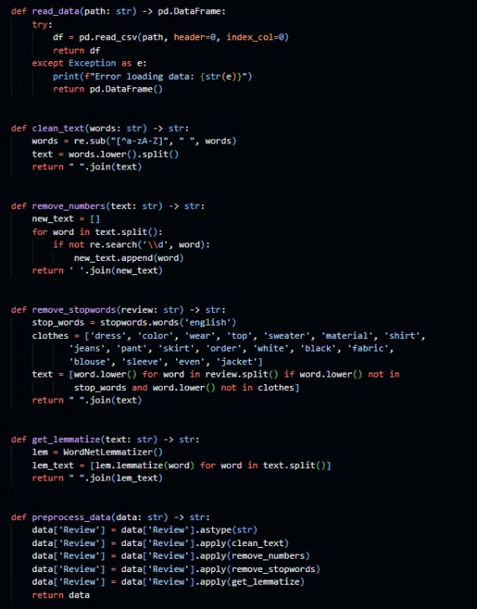
Pre-processing
read data
clean text
remove numbers
remove stopwords
get lemmatize

Slide 7
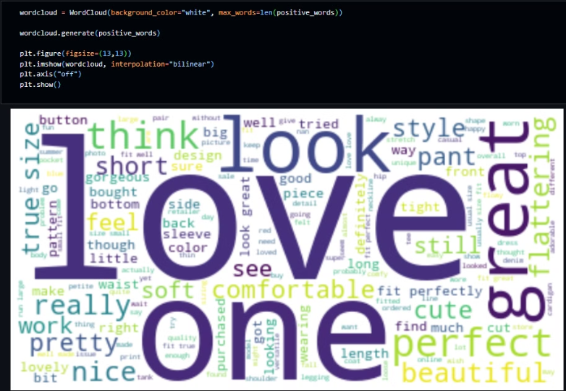
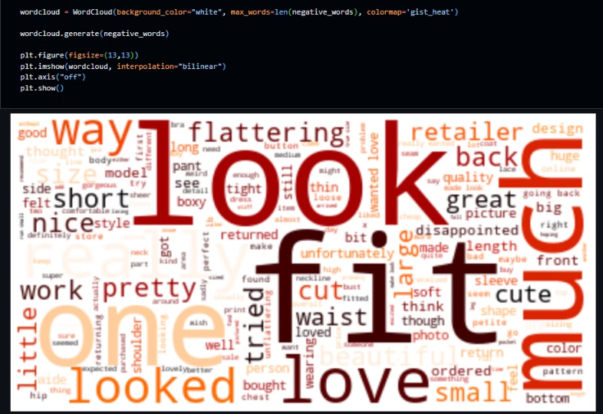
Positive Words
Negative Words
Sentiment Imbalance
Remove one half of + reviews
1→19314
1→8000
0→4172
0→4172

Slide 8
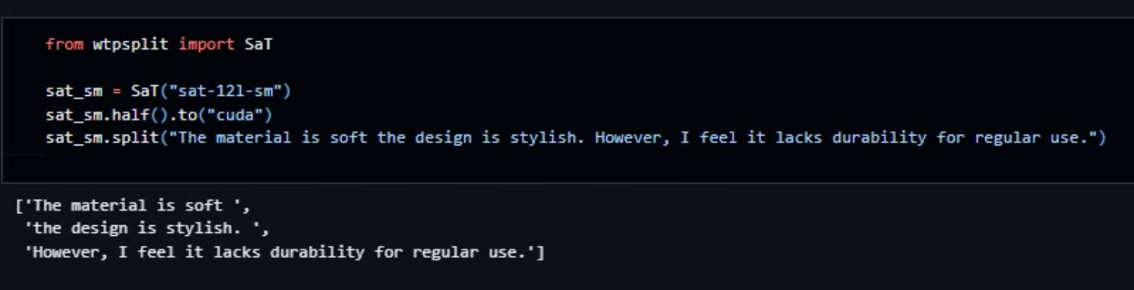
Sentence Boundary Segmentation

Slide 9
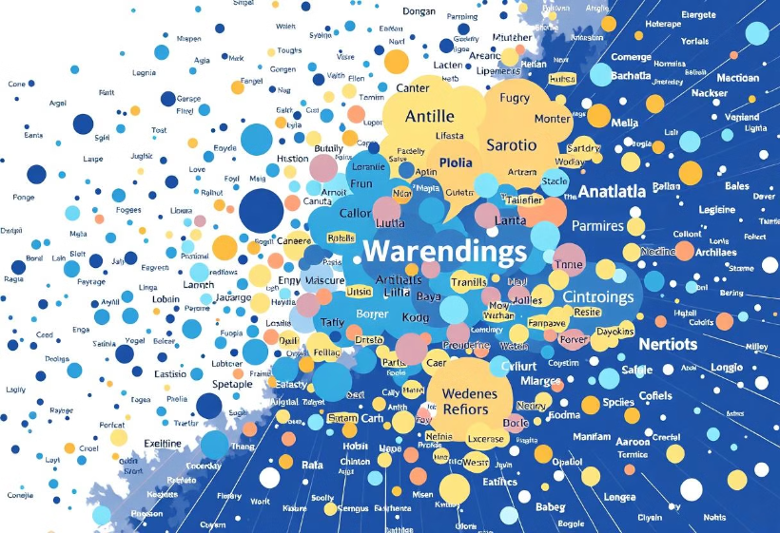
Glove Embeddings
Glove Embeddings
GloVe embeddings are a popular technique for representing words as dense vectors. These vectors capture semantic relationships between words, meaning words with similar meanings will have vectors close to each other in vector space.

Slide 10
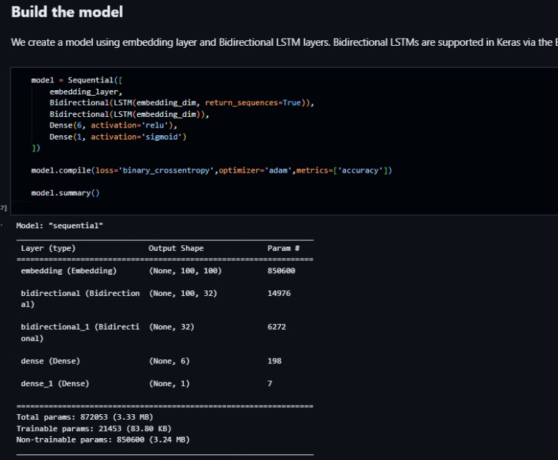
BiDirectional LSTM

Slide 11
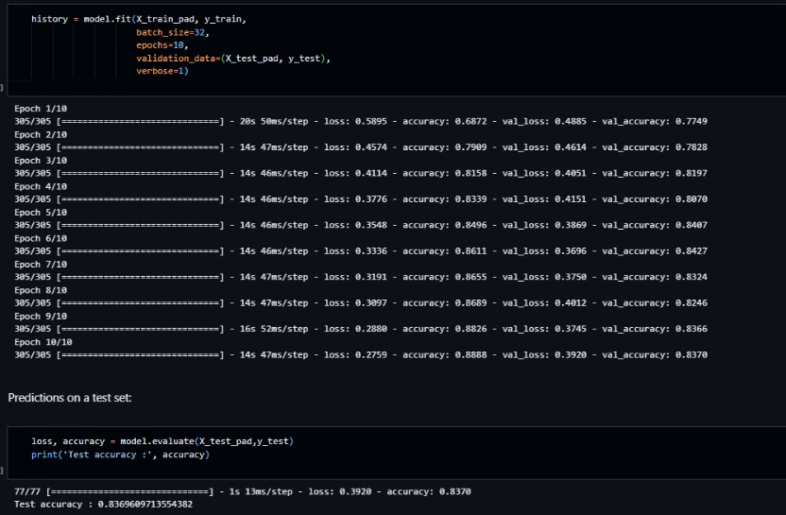
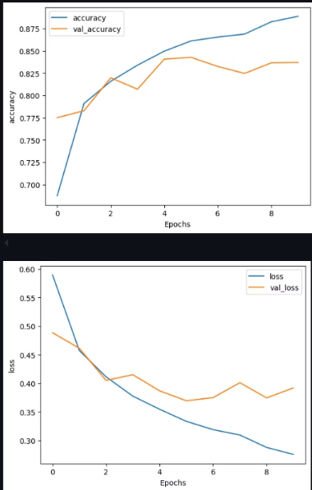

Slide 12
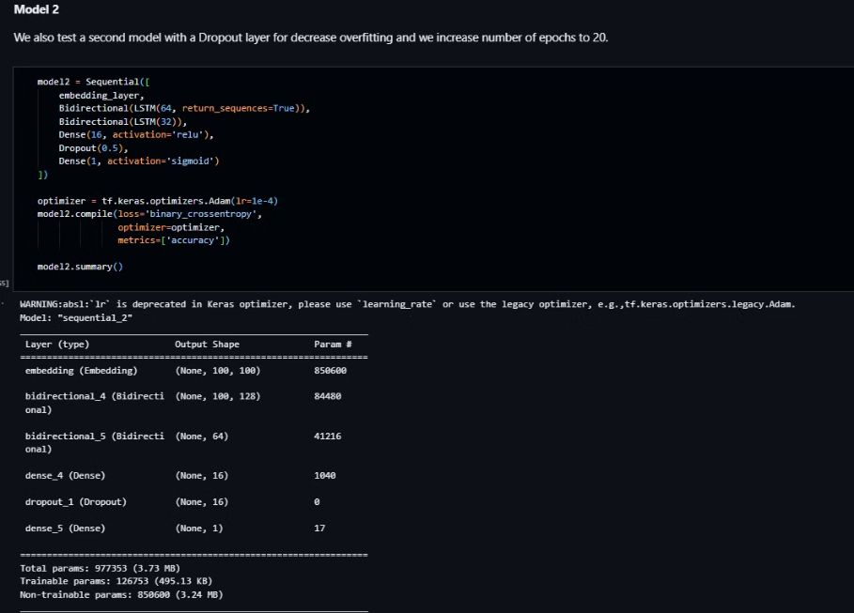
With Dropout

Slide 13
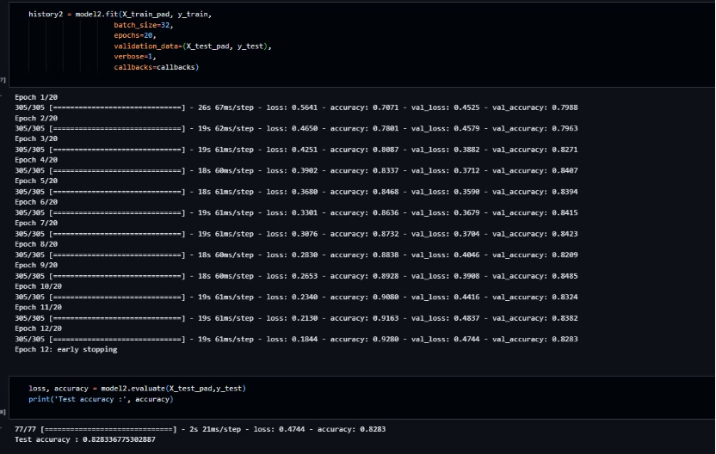
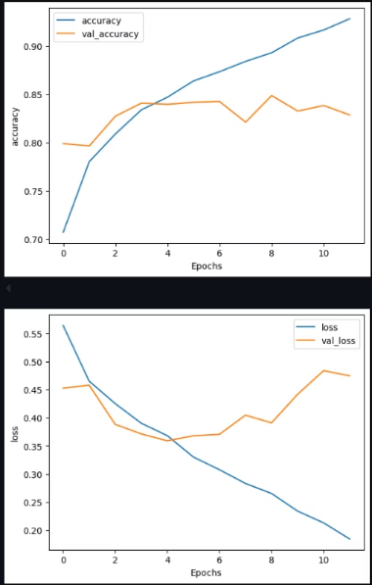

Slide 14
Aspect Classification
Goal
Approach
Challenges
Categorize sentences into predefined aspects (e.g., Fit, Fabric).
Generate a synthetic dataset using LLM.
Ambiguity in aspect relevance.
Train a transformer for doing aspect classification
Filtering irrelevant sentences.
Handles multiple aspects in a single review.

Slide 15
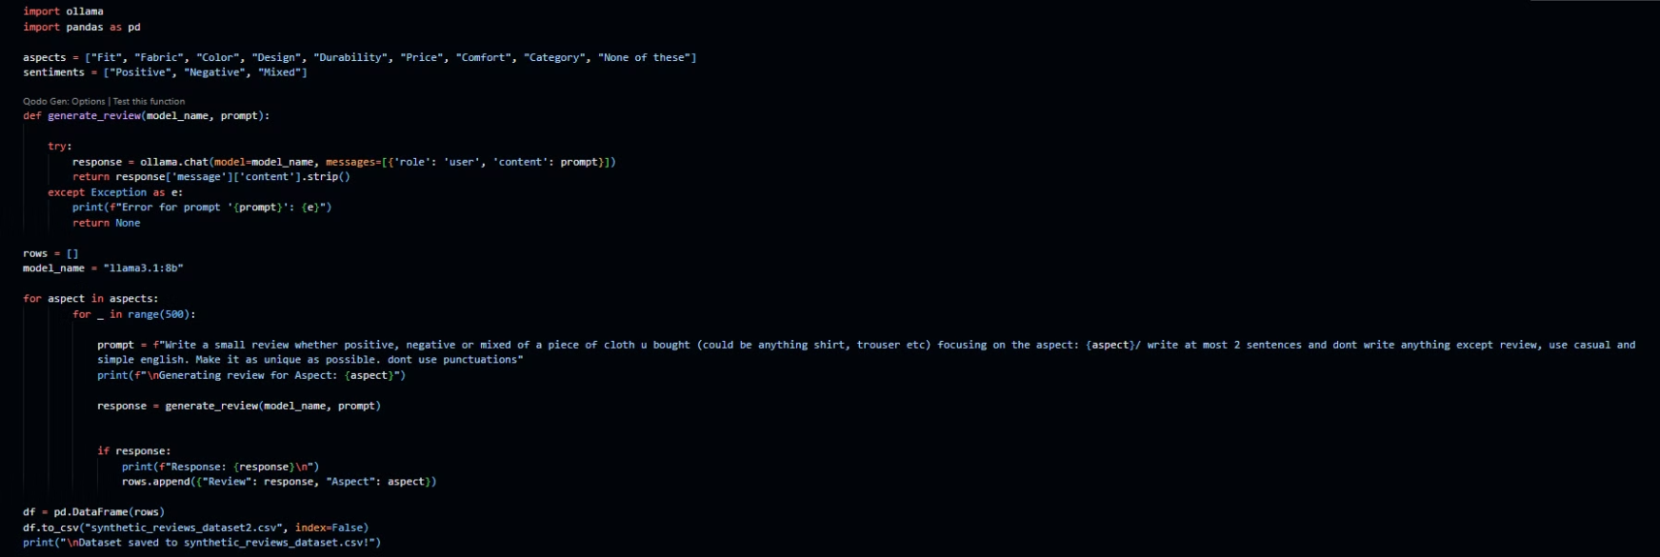
Use llama3:8b For Data Generation

Slide 16
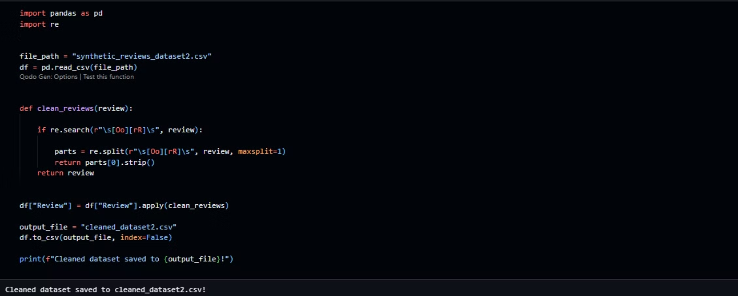
"I'm loving this new shirt I got but the fit is a bit off - its too loose in the sleeves and too tight around the waist giving me an awkward silhouette
or
I was hyped about my new joggers but they're totally off the mark with the fit - way too baggy and sloppy for my liking",Fit

Slide 17
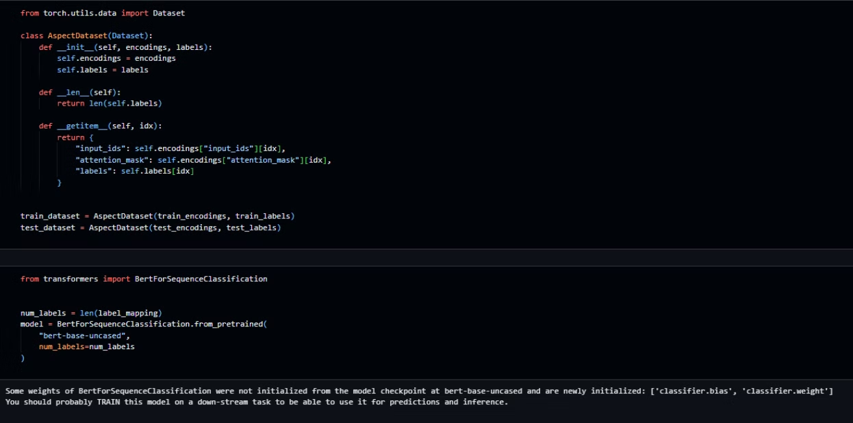
BERT (Pre Trained)

Slide 18
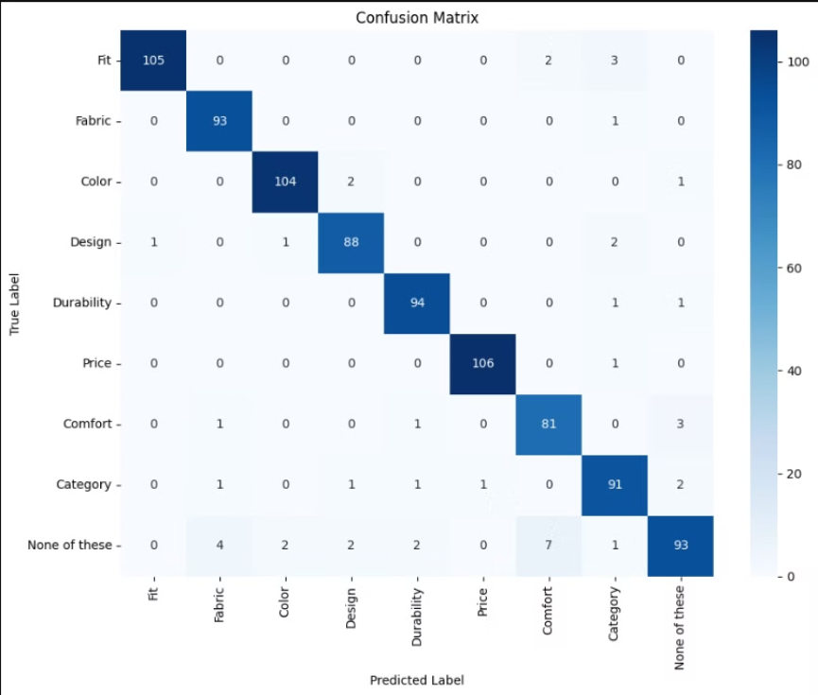

Slide 19
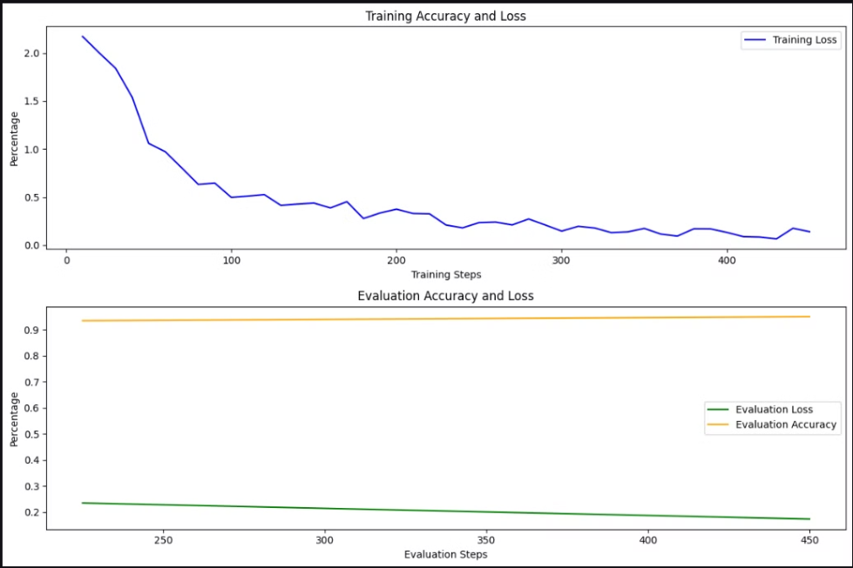

Slide 20
Recommendation Logic
Personalization:
Users specify preferences for aspects (e.g., prioritize Fit).
Products scored based on aspect alignment.
Computation:
Weighted dot product for similarity scoring.
Top n recommendations sorted by score.

Slide 21
Deployment
Platform: Flask for backend APIs.
Frontend:
HTML/CSS/JavaScript for dynamic product displays.
Database: SQLite for managing users, products, and reviews.

Slide 22
Results and Insights
System Performance:
Accuracy: ~85% for sentiment classification.
Real-time updates for new reviews.
Impact:
Improved recommendation relevance.
Enhanced user satisfaction through personalization.

Slide 23
Challenges and Limitations
Data Challenges:
Ambiguity in reviews (e.g., sarcastic comments).
Imbalanced datasets affecting model performance.
Real-time Reviews:
Real-time reviews can be challenging as the data for aspect classification is synthetic and cannot accurately capture reality.

Slide 24
Conclusion
Summary:
Impact:
ABSA recommender system bridges customer feedback and personalized shopping experiences.
Drives user engagement and business outcomes.

